Slide 1
AWS FOUNDATIONS - DAY 1
Virtualization & Cloud
The idea behind the cloud - from one physical server to global infrastructure
Virtualization
Cloud Computing
AWS
DNS
Networking

Slide 2
VIRTUALIZATION
From Physical to Virtual
One server, split into many isolated machines
VM 1
VM 2
VM 3
APPLICATIONS
everything shares one OS
APP
APP
APP
OS
OS
OS
OPERATING SYSTEM
VIRTUALIZATION LAYER
HARDWARE
HARDWARE
TRADITIONAL - 1 server, 1 OS
VIRTUAL - 1 server, many isolated VMs

Slide 3
VIRTUALIZATION
What Is Virtualization?
One physical machine split into many independent virtual ones
Software splits the server
one physical server
a special layer divides one physical server into multiple virtual machines (VMs)
VM 1 - own OS + apps
Each VM is independent
VM 2 - own OS + apps
it runs its own operating system and its own apps, fully isolated from the neighbours
VM 3 - own OS + apps
Hardware is shared
CPU, memory and disk are shared underneath - yet every VM behaves like a real, separate computer
isolated - a crash in VM 1 never touches VM 2

Slide 4
VIRTUALIZATION
The Hypervisor
The thin software layer that creates and runs the VMs
Its job: hand every VM a fair slice of CPU, memory and storage - and keep the VMs strictly separated.
Type 1 - bare metal
Type 2 - hosted
VM | VM
VM | VM | VM
HYPERVISOR
HYPERVISOR
YOUR OS (Windows/macOS)
HARDWARE
HARDWARE
Runs directly on the hardware. Used in data centers - this is what AWS runs.(VMware ESXi)
Runs as an app on top of a normal OS. Used on laptops - e.g. VirtualBox, VMware Workstation.

Slide 5
VIRTUALIZATION
Why It Matters
Efficiency
Isolation
Speed & flexibility
One powerful server runs many workloads instead of sitting mostly idle - far less wasted money and electricity.
A crash or an attack inside one VM never affects the other VMs sharing the same machine.
A new 'server' is created in seconds and thrown away when you're done - no cables, no delivery trucks.
This is the foundation.
Virtualization is what makes cloud computing possible, fast, and affordable.

Slide 6
CLOUD COMPUTING
What Is Cloud Computing?
On-demand IT resources over the internet, pay-as-you-go
The core idea
Key benefits
Rent, don't buy - computing, storage and networking on demand instead of owning hardware
No upfront cost - big capital expenses become small monthly bills
Lives in data centres - resources sit in the provider's buildings and you reach them over the internet
Global in minutes - deploy near your users; capacity stretches to match demand
Pay as you go - pay only for what you use; scale up or down at any moment
Less to worry about - the provider handles the building, power, cooling and hardware

Slide 7
CLOUD COMPUTING
Who Provides the Cloud?
Three names you'll hear.
Amazon Web Services
Microsoft Azure
Google Cloud Platform
The first major cloud provider (2006) and still the largest and most mature platform.
Deep ties to Windows, Office 365 and Active Directory make it a natural fit for enterprise IT.
Built on Google's own infrastructure, with standout strength in data, analytics and ML.

Slide 8
CLOUD COMPUTING
Types of Cloud Deployment
Where your resources live - and who shares them
Public cloud
Private cloud
Hybrid cloud
Shared infrastructure owned by a provider, open to everyone over the internet. Cheapest, fully managed.
Dedicated to a single organisation - maximum control and isolation, often for strict compliance.
A connected mix: keep sensitive data on-premises, burst to the public cloud for scale.
e.g. AWS, Azure, GCP
e.g. VMware, OpenStack on-prem
e.g. AWS Outposts, Azure Arc
Bonus: multi-cloud
Using more than one public cloud at once (AWS + Azure) to avoid vendor lock-in and pick the best of each. Most companies start with ONE public cloud - hybrid and multi-cloud come later.

Slide 9
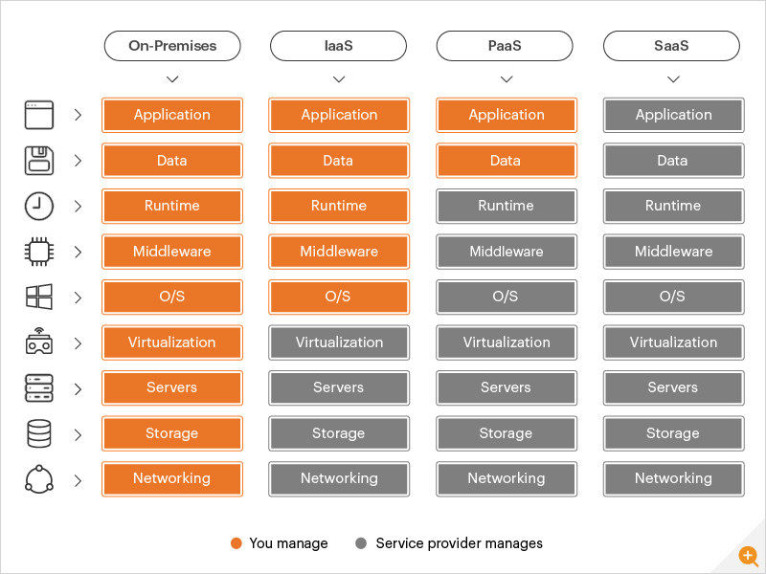

Slide 10
CLOUD SERVICE MODELS - CLASS ACTIVITY
IaaS, PaaS, or SaaS? You Decide!
Read each example, discuss with the class, then vote
Amazon EC2
?
AWS Elastic Beanstalk
?
You rent a virtual machine and manage the OS, runtime and apps yourself.
You upload your code - the platform manages servers, OS and runtime for you.
Google Workspace
?
Gmail
?
You just open the app in a browser - everything underneath is fully managed.
You store and sync files - no servers, no setup, no maintenance at all.
Your options:
IaaS
PaaS
SaaS

Slide 11
CLOUD SERVICE MODELS
Here's the Answer!
Check your guesses against the correct model
Amazon EC2
IaaS
AWS Elastic Beanstalk
PaaS
You rent a virtual machine and manage the OS, runtime and apps yourself.
You upload your code - the platform manages servers, OS and runtime for you.
Gmail / Google Workspace
SaaS
Dropbox
SaaS
You just open the app in a browser - everything underneath is fully managed.
You store and sync files - no servers, no setup, no maintenance at all.
Your options:
IaaS
PaaS
SaaS

Slide 12
AWS
Why Choose AWS?
What makes it the market leader
Market leadership
Breadth of services
First major cloud provider (2006) and still the largest - the most mature, battle-tested platform.
200+ services across compute, storage, databases, AI/ML and analytics - almost anything already exists as a managed service.
Global footprint
Ecosystem & trust
Dozens of Regions and Availability Zones worldwide - deploy close to users for low latency and local data rules.
Huge community, deep documentation, respected certifications, pay-as-you-go pricing and a generous free tier.
This course uses AWS for all hands-on work - but the concepts transfer to any cloud.

Slide 13
THE ROAD AHEAD
What We'll Learn in This Course (and more!)
Compute & scaling
Storage & databases
EC2
ECS / ECR
Lambda
ELB
S3
RDS
Aurora
DynamoDB
ElastiCache
Auto Scaling
Security, ops & delivery
IAM
Route 53
Don't memorise these now - by the end of the course each name will feel like an old friend.

Slide 14
AWS
AWS Global Infrastructure
Four building blocks, from biggest to smallest
1
Regions
separate geographic areas around the world (us-east-1, eu-west-3, ...)
2
Availability Zones
isolated clusters of data centers inside each region
3
Data Centers
the actual buildings full of servers
4
Edge Locations
small sites in 90+ cities that cache content close to users

Slide 15
AWS
How to Choose an AWS Region?
Launching a new application - where should it live?
Compliance
Proximity
Data governance and legal requirements - data never leaves a region without your explicit permission.
Closer to your customers = lower latency. Users in Cairo? Prefer a nearby region.
Available services
Pricing
New services and features don't arrive in every region at once - check yours has what you need.
Prices differ from region to region and are fully transparent on each service's pricing page.
The four questions to ask, in order: is it legal? is it close? does it have my services? what does it cost?

Slide 16
AWS
Availability Zones (AZs)
Several per region
AWS Region
Sydney: ap-southeast-2
usually 3 zones - minimum 3, maximum 6
ap-southeast-2a
data centers
One or more data centers each
with redundant power, networking and connectivity
Physically separated
far enough apart to be isolated from disasters
ap-southeast-2b
data centers
ap-southeast-2c
data centers
Tightly connected
high-bandwidth, ultra-low-latency private links

Slide 17
AWS
Points of Presence (Edge Locations)
Tiny AWS sites everywhere, so content reaches users fast
400+
10+
90+
40+
Edge Locations
Regional Caches
cities
countries
What they're for
Popular content (videos, images, downloads) is cached at the edge, physically near the user - so it's delivered with much lower latency. This is how CloudFront (AWS's CDN) works.
Regions run your applications - edge locations deliver your content.

Slide 18
AWS
The Shared Responsibility Model
Security is a partnership - each side owns a layer
Customer data
CUSTOMER
security IN the cloud
Apps, platform, IAM (users & permissions)
OS, network & firewall configuration
Encryption - client side, server side, in transit
Software - compute, storage, database, networking services
AWS
security OF the cloud
Hardware - the physical servers and equipment
Global infrastructure - regions, AZs, edge locations
Memory trick: AWS secures the cloud itself - YOU secure what you put in it.

Slide 19
DNS
What Is DNS?
The internet's phonebook - names in, IP addresses out
Domain Name System: translates human-friendly names into the numeric IP addresses machines actually use.
www.google.com
DNS lookup
172.217.18.36
Why it matters
Hierarchical names
Without DNS you'd memorise numbers for every website. It's the backbone of the internet - almost every connection starts with a DNS lookup.
.com
top level
example.com
the domain
www.example.com / api.example.com
subdomains

Slide 20
DNS
How DNS Works - Finding example.com
Your local DNS server asks the hierarchy, top to bottom
1
Browser asks the local DNS server
"what is the IP of example.com?" - this server is run by your company or ISP
2
Local DNS asks a Root server
root replies: "I don't know, but the .com TLD server is at 1.2.3.4"
3
Local DNS asks the .com TLD server
TLD replies: "ask example.com's own name server at 5.6.7.8"
4
Local DNS asks that SLD name server
it holds the zone file and answers: "example.com = 9.10.11.12"
5
Answer returns and is cached
the browser connects to 9.10.11.12 - next time, the cached answer is instant (until its TTL expires)
Root is managed by ICANN, TLDs by IANA, and your domain's server by your registrar (e.g. Route 53).

Slide 21
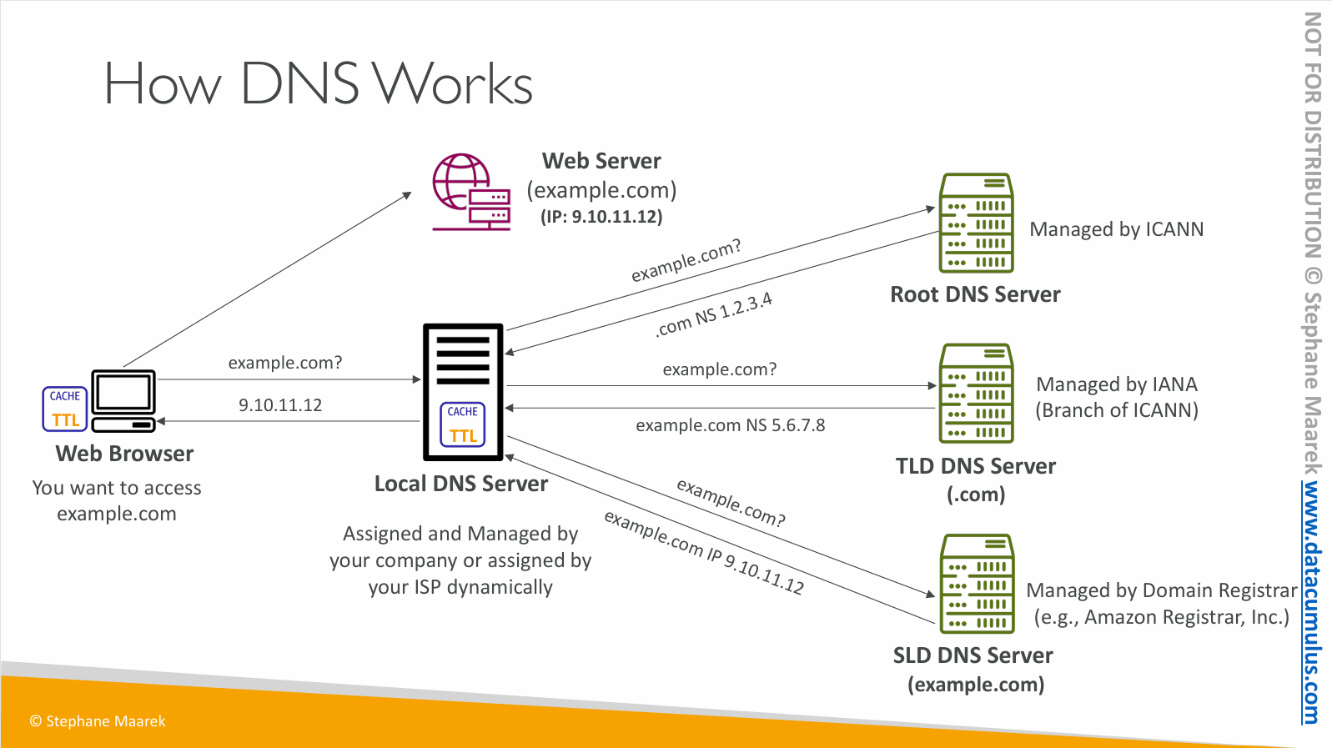

Slide 22
PRIVATE VS PUBLIC IP
Two Kinds of Addresses
Inside your network vs. out on the internet
Your home network
Laptop 192.168.1.10
The Internet
sees one address only:
203.0.113.5
your public IP (from your ISP)
Router
Phone 192.168.1.11
Smart TV 192.168.1.12
private addresses - only exist in here
Private IP = a room number
'Room 12' means something inside your building only. Every building can have a Room 12.
Public IP = your street address
Unique in the whole world - it's how anyone, anywhere can reach your building.

Slide 23
PRIVATE VS PUBLIC IP
Side by Side
PRIVATE IP
PUBLIC IP
Assigned by
your router / network admin
your ISP
Unique?
only inside your own network
worldwide - no two alike
Works on internet?
no - internet routers drop it
yes - reachable from anywhere
Cost
free - use as many as you like
paid / limited (only ~4.3 billion exist)
Example
192.168.1.10
203.0.113.5
Both work together: devices use private IPs inside, and share one public IP to reach the internet (that swap is NAT - coming soon).

Slide 24
IP ADDRESSING
The 5 Classes of IPv4
The first octet tells you the class
Class
First octet
Default mask
Used for
A
1 - 126
255.0.0.0 (/8)
huge networks - millions of hosts
B
128 - 191
255.255.0.0 (/16)
medium networks - universities, big companies
C
192 - 223
255.255.255.0 (/24)
small networks - homes and offices (most common)
D
224 - 239
-
multicast - one sender to many receivers
E
240 - 255
-
experimental - reserved, never assigned
Where is 127? 127.x.x.x is loopback - it always means 'this device itself' (that's why A stops at 126).

Slide 25
PRIVATE VS PUBLIC IP
The Private Ranges (RFC 1918)
One reserved private range inside each class - memorise these three
Class A
Class B
Class C
10.0.0.0
↓
10.255.255.255
172.16.0.0
↓
172.31.255.255
192.168.0.0
↓
192.168.255.255
10.0.0.0/8
172.16.0.0/12
192.168.0.0/16
~16.7 million addresses
~1 million addresses
65,536 addresses
Seen in: big enterprises, AWS VPCs
Seen in: medium networks, Docker defaults
Seen in: your home Wi-Fi router
The rule that makes them 'private'
Internet routers refuse to carry these addresses. That's why every home can reuse 192.168.1.1 - the addresses never meet on the internet.

Slide 26
VPN
What Is a VPN?
Virtual Private Network - a private, encrypted tunnel over the public internet
You
on cafe Wi-Fi
the public internet
VPN server
company or provider
encrypted tunnel - nobody outside can read what's inside
outsiders see only: x9#Kf$2p... (gibberish)
The one-line definition
A VPN wraps your traffic in encryption and carries it through a tunnel to a trusted server - so you get a PRIVATE connection while using PUBLIC internet cables.

Slide 27
NAT
What Is NAT?
Network Address Translation - the bridge between private and public
The problem: private IPs (192.168.x.x ...) are dropped by internet routers. So how does your phone browse the web?
Router doing NAT
swaps the source address:
192.168.1.10 → 203.0.113.5
Your laptop
192.168.1.10
Website server
sees only 203.0.113.5
The router keeps a translation table, so when the reply comes back it knows exactly which inside device asked for it.
Why NAT is everywhere
There are only ~4.3 billion IPv4 addresses - not enough for every phone, TV and fridge. NAT lets a WHOLE network of private devices share one public IP. It's why IPv4 still survives today.

Slide 28
NAT
The 3 Types of NAT
Static NAT
Dynamic NAT
PAT / NAT Overload
1 : 1
many : pool
many : 1
One private IP permanently mapped to one public IP.
Private IPs grab a public IP from a pool - first come, first served; returned when done.
Everyone shares ONE public IP - the router tells sessions apart by PORT number.
Use it when: an inside server (web, mail) must always be reachable from the internet.
Use it when: you own several public IPs and devices only need them sometimes.
Use it when: always. This is your home router and the AWS NAT Gateway.
the one you use every day
PAT example: laptop 192.168.1.10:5001 → 203.0.113.5:40001 | phone 192.168.1.11:5002 → 203.0.113.5:40002

